Slide 1
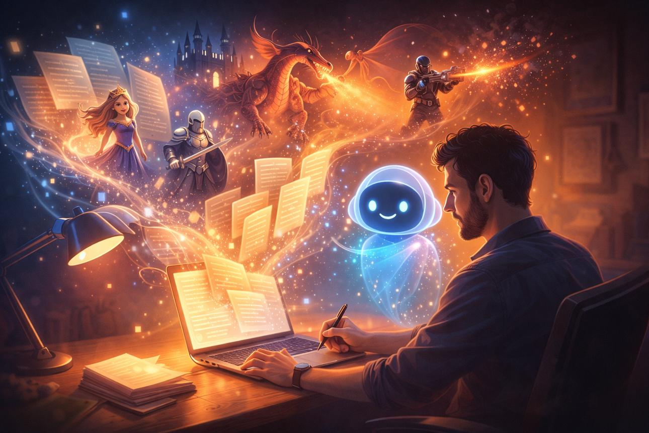
Story Idea Generator
Prepared by
Vaishnavi Panchal
Prompt Engineering Assignment

Slide 2

Problem Statement
Writers often face writer's block and struggle to create fresh story ideas.
This project designs an AI prompt that generates original stories from a genre, theme, and character type.

Slide 3
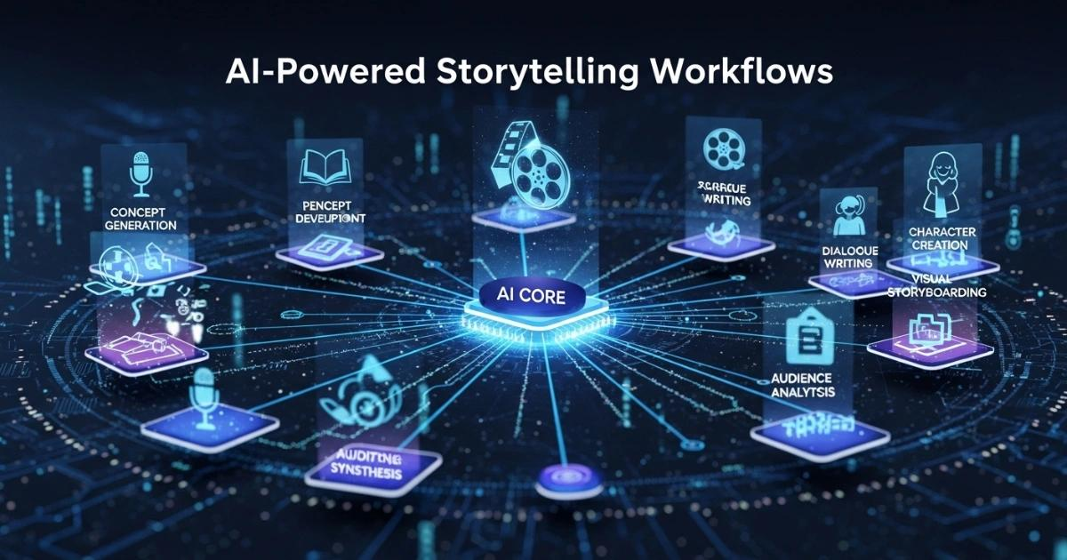
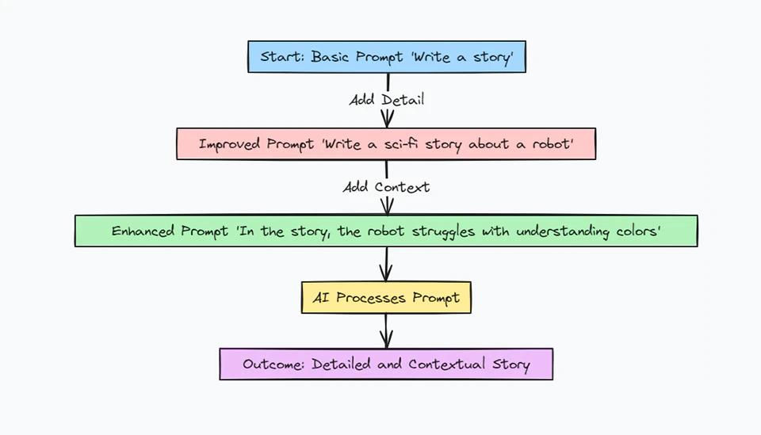
Proposed Solution
User
↓
Genre + Theme + Character
↓
AI Prompt
↓
Creative Story
• User enters Genre
• User enters Theme
• User enters Main Character
AI generates:
✓ Title
✓ Setting
✓ Story Idea
✓ Plot Twist
✓ Ending

Slide 4

Features
✨ Original story generation
🎭 Multiple genres
💡 Creative themes
🧙 Custom characters
🔀 Unexpected plot twists
📑 Structured output

Slide 5


Technology / Tools Used
🤖 ChatGPT
📝 Prompt Engineering
💻 Microsoft PowerPoint
🧠 Natural Language Processing (NLP)

Slide 6
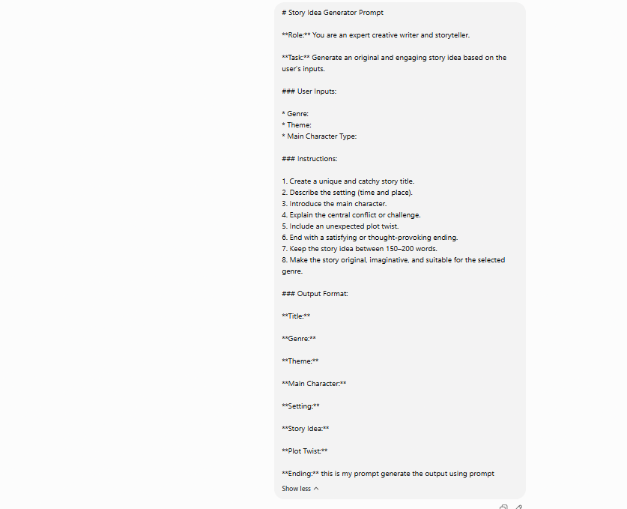
Screenshots / Demo Images
screenshots of:
1. prompt

Slide 7
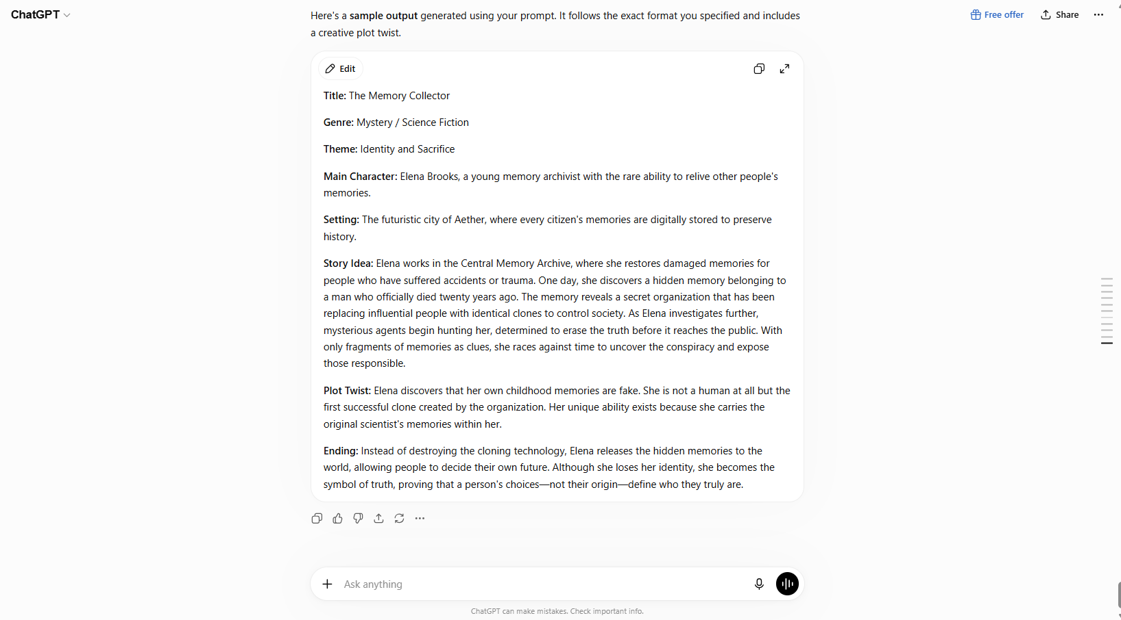
2. AI-generated story output

Slide 8
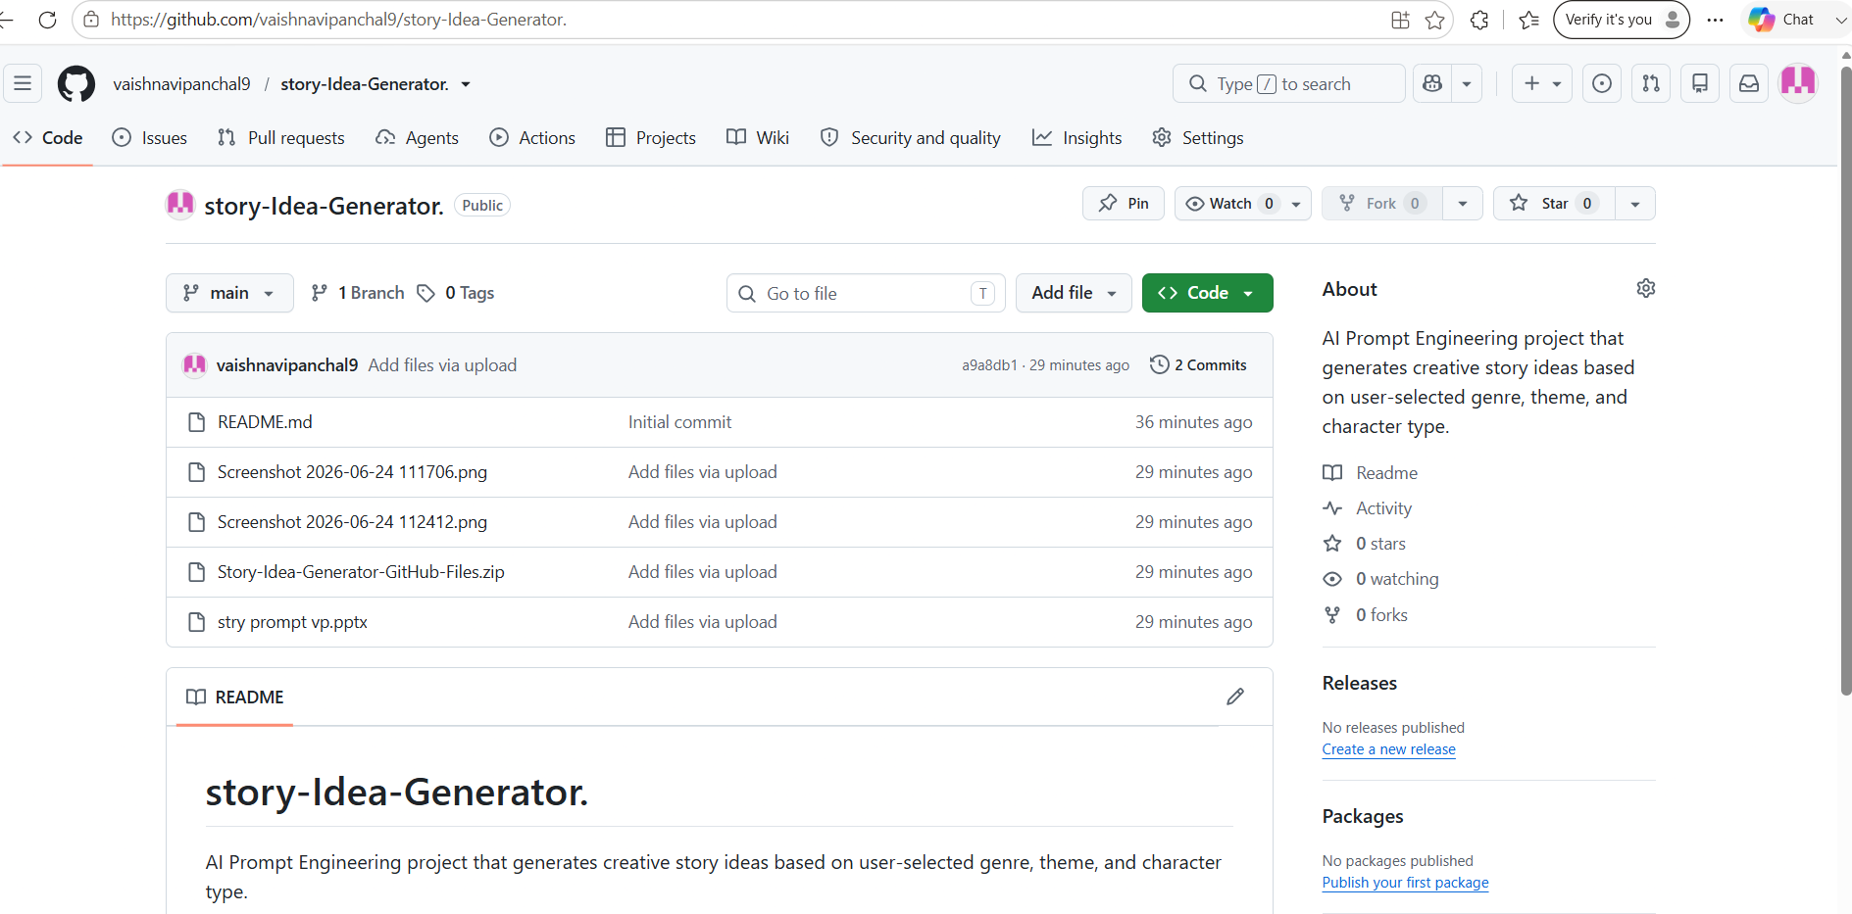
Git Hub Repository
Git repository link:
https://github.com/vaishnavipanchal9/story-Idea-Generator..git

Slide 9
Conclusion
The Story Idea Generator showcases how well-crafted prompts help AI produce creative, engaging, and structured story ideas, making content creation faster and more inspiring.

Slide 10


